Slide 1
Canandaigua National Bank Financial Literacy Communications Plan
SUNY Buffalo State University | November 2026
Jordan Wethington

Slide 2
Analysis of the Issue
Financial literacy gaps are widening across all age groups.
Consumers face rising overspending, under-saving, high-interest debt, and fraud risks.
Public trust weakened by past banking scandals and inequitable access to financial resources.
Lack of early financial education leaves many ill-equipped to manage money.
Impacts multiple demographics: students, families, homeowners, retirees, and older adults.
Issue closely tied to CNB’s relationship with its community and stakeholders.

Slide 3
Resolutions for the Issue
Requires clear, accessible, and consistent financial education across all life stages.
CNB should tailor programs to diverse needs while reinforcing transparency and trust.
A balanced approach must empower the community while supporting organizational goals.
Issue merits top priority due to its impact on trust, stability, and long-term growth.
CNB’s resilience shows readiness to lead as a trusted, community-focused financial educator.

Slide 4
Significance of the Issue
Directly supports CNB’s mission of stewardship, education, and community wellbeing.
Requires long-term commitment due to evolving financial challenges.
High public expectation for banks to provide transparent, proactive financial education.
Strong opportunity for CNB to strengthen loyalty and differentiate from competitors.
Failure to address the issue risks reputational damage, declining trust, and lost financial growth.

Slide 5

Analysis of the Organization
Canandaigua National Bank
Positioned as a regional leader in financial literacy and as a leading financial institution.
Known for community focus, local decision‑making, personalized products & services.
Competitors:
  Five Star (Digital Opponent)
  Lyons National Bank (Grassroots/Community)
  ESL (Community)
Strongest in social reach but conservative in style.

Slide 6
Internal Environment
Strong community-rooted, customer-first culture.
Only locally owned full-service bank in the Monroe, Ontario, and now the Onondaga regions.
Robust communication resources: web, email, social media, newsletters, mail, phone.
Dedicated PR and marketing staff with solid outreach budget.
Leadership - Frank Hamlin, who is highly supportive of communication efforts.
Mission-driven focus on empowering individuals, businesses, and the community.

Slide 7
Public Perception
Widely viewed as a trusted, stable, and community-committed bank.
Reputation marked by credibility, visibility, and long-standing local engagement.
Positive regional identity reinforced through service expansion and modernization.
The public sees CNB as more than a bank; they are an invested community partner.

Slide 8
External Environment – Competitors
Five Star Bank
  Modern, digital-forward brand with sleek web presence.
  Strong Financial Education Hub with interactive modules.
  Polished Instagram with high engagement on local business stories.
  Lyons National Bank (LNB)
    Emphasizes warmth, community ties, and accessibility.
    Conversational, family-oriented tone on website and social media.
    Strong grassroots engagement and local visibility.

Slide 9
Other Externals
Rising consumer expectations for digital service and transparency.
Regulatory shifts and economic pressures affecting banking communications.
Industry-wide trust challenges.
Ever-shifting environment.

Slide 10
Customers
Core: Homeowners, families, small/midsize businesses, nonprofits, municipalities.
Consumer segments: first-time homebuyers, families, working professionals, and retirees.
Business segments: owner-operators, regional firms needing responsive lending.
Growing segment: students and young adults entering financial independence.
Customers Value: local decision-making, personalized support, financial education.

Slide 11
Identification of Publics
Primary Customers/Customers: Individuals, families, and small–medium businesses in Greater Rochester & Finger Lakes.
  Rely on CNB for personal banking, mortgages, wealth management, and business lending.
  Needs have shifted toward digital access, personalized services, and financial literacy tools.
  Demand for advanced digital platforms and education-based initiatives expected to accelerate.

Slide 12
Identification of Publics
Producers
  Consist of CNB bankers, advisors, financial specialists, tech partners, vendors, and board members.
  Have modernized tools, expanded advisory services, and led major rebranding efforts.
  Will continue growing in expertise as CNB expands into Syracuse and broadens services.

Slide 13
Identification of Publics
Enablers
  Include regulators, media outlets (13 WHAM, News 10), and community partners.
  Provide oversight, credibility, and platforms to amplify CNB messaging.
  Increasing emphasis on transparency and digital communication strengthens their role.

Slide 14
Identification of Publics
Limiters
  Primary limiters are their competitors: ESL, Five Star, GRB, M&T, LNB, NBT.
  Compete for market share through digital services, customer incentives, and regional expansion.
  Their strengthened positions require CNB to differentiate through trust, education, and local ownership.

Slide 15
Identification of Publics
Intercessory Publics & Opinion Leaders
  Influencers include elected officials, chambers of commerce, nonprofit leaders, and educators.
  Informal leaders: family advisors, religious figures, neighborhood advocates.
  Strong likelihood of support due to CNB’s community-first reputation and literacy mission.

Slide 16
Content Analysis
Overall Social Media Performance
  CNB leads competitors in engagement and reach across platforms.
  Follower counts: CNB 1,700+ (LinkedIn), 5,000+ (Facebook) → higher than Five Star & LNB.
  Content volume: CNB 3,000+ posts, far surpassing LNB (119) and Five Star (1,294).CNB maintains strong visibility but with a more formal, conservative brand tone.
  Competitor Comparison
  Five Star: Strong digital branding; interactive education tools; polished, modern aesthetic.
  LNB: Warm, grassroots tone; highly relatable and community-focused content.
  CNB: Dominant in reach and volume; consistent professionalism but less interactive.

Slide 17
Content Analysis
(Social Platforms)
LinkedIn
  Professional, polished, and credibility-focused.
  Highlights staff achievements, financial literacy, and community events.
  Strong consistency but limited conversational or interactive engagement.
Instagram
  Clean, traditional aesthetic with staff, branches, and financial tips.
  Uses Stories but minimal reels, videos, or youth-friendly interactive content.
  Opportunity to incorporate behind-the-scenes, Q&A, and short-form video.
Facebook
  Strongest platform with 5,000+ followers and steady posting.
  Showcases community commitment (events, partnerships, branch features).
  Engagement skews toward likes rather than comments/shares → limited deeper interaction.
Website
  Clear, professional, user-friendly hub for tools, newsletters, resources.
  Lacks interactive or youth-oriented digital experiences.

Slide 18
Content Opportunities
CNB excels in reach, consistency, and brand stability.
Style remains more formal compared to competitors’ modern or grassroots approaches.
Opportunities to expand - Interactive posts, short-form video, storytelling, and youth-focused content.
Modernization could strengthen engagement, attract new generations, and deepen community connection.

Slide 19
Positioning Statement
For community members of all ages seeking greater financial literacy and trusted financial guidance, CNB can establish itself as the premier locally owned financial institution in the region. CNB can leverage its strong community ties, personal service, and long-standing reputation to provide engaging and transparent financial education opportunities. By expanding awareness of existing programs, such as “Money Squad” for youth and retirement seminars for older adults, as well as introducing new interactive digital tools, CNB can be recognized as both a trusted financial partner and a leader in literacy across generations.

Slide 20
Goals
Reputational Goals
  Establish CNB as the most trusted, visible financial literacy leader in the region.
  Reinforce brand identity centered on education, community, and transparency.
Relationship Goals
  Strengthen connections with diverse audiences across age groups.
  Expand partnerships with schools, nonprofits, influencers, and community organizations.
  Increase visibility of literacy programs for youth, adults, and retirees.
Task Goals
  Modernize outreach using CNB’s strong digital presence.
  Add interactive formats: webinars, reels, calculators, Q&A sessions.
  Complement traditional workshops with engaging digital content.

Slide 21
Objectives
Awareness Objective
  Boost recognition of CNB literacy programs by 15% within one year.
Acceptance Objective
  Increase website/social media engagement by 25% through interactive, youth-oriented campaigns.
Action Objective
  Increase seminar participation, school partnerships, and literacy-linked account openings by 30% within one year.

Slide 22
Proactive & Reactive Strategies
Action Strategy
  Expand existing financial literacy programs across all ages (Money Squad, retirement seminars).
  Strengthen promotion, survey, and focus group showed that many customers are unaware of current workshops and tools.
  Increase CNB staff presence at community events and local sponsorships.
  Reinforce CNB’s identity as a community-centered bank serving individuals & businesses.
Communication Strategy
  Shift from conservative tone to more engaging, interactive content.
  Add reels, podcasts, behind-the-scenes posts, and Q&A sessions to reach younger audiences.
  Use clear storytelling about community work, fraud protection, and fee reductions.
  Utilize newsletters, digital tools, school presentations, and branch communication.

Slide 23
Proactive & Reactive Strategies
Proactive Strategy
  Maintain consistent visibility through partnerships with schools, nonprofits, and influencers.
  Sponsor community initiatives and provide hands-on tools (calculators, worksheets, workshops).
  Share newsworthy customer success stories and financial education content.
  Position CNB as both a financial provider and a long-term financial wellness partner.

Slide 24
Proactive & Reactive Strategies
Reactive Strategy
  Use defensive responses emphasizing transparency, fairness, and community ownership.
  Address issues through corrective action, restitution, and empathetic communication.
  Apply vocal commiseration (express regret/apology when appropriate).
  Use strategic silence when immediate comment could worsen public perception.

Slide 25
Proactive & Reactive Strategies
Rectifying Behavior Strategy
  Respond quickly and authentically when behaviors or issues threaten reputation.
  Implement corrective measures aligned with CNB’s mission and values.
  Prioritize transparency and honesty to rebuild trust.
  Demonstrate learning and improvement in all follow-up actions.

Slide 26
Developing the Message Strategy
Message Source – Dario Saccente
  Wealth Advisor serving as the primary spokesperson for CNB.
  Brings credibility in investments, retirement planning, and long-term financial guidance.
  Viewed as trustworthy due to expertise and community-based presence.
  Communicates complex topics in clear, relatable language for all age groups.
  Reinforces CNB’s mission of personalized service, transparency, and financial education.

Slide 27
Message Appeal
Rational Appeals
  Highlights CNB’s strengths: social media leadership, community partnerships, youth programs, and retirement seminars.
  Uses testimonials and success stories to show impact.
  Differentiates CNB as the only locally owned bank with consistent literacy offerings.
Emotional Appeals
  Focuses on empowerment, stability, and community pride.
  Encourages youth to feel confident starting their financial journey early.
  Reassures older adults of security and peace of mind in retirement.

Slide 28
Communications
Verbal Communication
  Prioritizes clarity, simplicity, and education—no jargon.Uses accessible terms: financial confidence, trusted partner, community focused.
  Power words: secure, empower, local ally.
  Memorable program names (e.g., Money Squad).
  Sample tagline: “Guidance You Can Trust, From Your Community’s Wealth Advisor.”
  Ethical, transparent language strengthens credibility.

Slide 29
Communications
Nonverbal Communication
  Consistent branding aligned with CNB’s new logo, colors, and polished identity.
  Dario uses approachable posture, eye contact, and warm tone at community events.
  His background as a professional comedian strengthens delivery and relatability.
  Visual storytelling through short videos/reels showing real conversations with clients.
  Timely updates via newsletters, social platforms, and digital tools reinforce trust.

Slide 30
Message Structure
Core Message
  “Our goal at CNB is to give everyone the tools and confidence to make smart financial decisions.”

Slide 31
Communication Tactics
Owned Media Tactics
Digital & Organizational Media
  Develop a Financial Literacy Hub with calculators, simulators, videos, and tutorials.
  Expand blog, newsletters, and in-branch materials to highlight educational tools.
  Monthly “Money Made Simple” email segments tailored by life stage.
Print & In-Branch Publications
  Brochures, posters, and flyers with QR codes linking to digital tools.
  Quarterly Community Impact Report showcasing progress and transparency.
Educational Events & Workshops
  Launch “Money in Motion” workshops (budgeting, credit, saving, retirement).
  Offer both in-person and virtual formats for accessibility.

Slide 32
Communication Tactics
Earned Media Tactics
  News releases announcing new tools, partnerships, and seminar series.
  Media kits with fact sheets, bios, quotes, and photos.
  Thought leadership: op-eds, radio/podcast interviews, public affairs segments.
  Feature stories on youth programs, Money Squad, and community education events.

Slide 33
Communication Tactics
Shared Media Tactics
  “Learn with CNB ” weekly content series across Facebook, Instagram, and LinkedIn.
  Short-form videos: Reels, YouTube Shorts, behind-the-scenes clips.
  Interactive campaigns (e.g., TikTok-style “30-Day Savings Challenge ”).
  Live Q&A sessions with advisors and customer discussion forums.
  Cross-promotions with schools, nonprofits, chambers, and partner organizations.

Slide 34
Communication Tactics
Paid Media Tactics
  Targeted ads promoting webinars, literacy tools, and first-time homebuyer resources.
  YouTube pre-roll educational spots.
  Sponsored columns (“Money Matters ”) and local radio segments.
  Branded materials for events: educational kits, calculators, reusable bags.

Slide 35
Integration & Strategic Impact
Owned = authority; Earned = credibility; Shared = engagement; Paid = expanded reach.
Most tactics use existing CNB staff and modest budgets; scalable during key seasons.
Moves CNB from informational to interactive, meeting public expectations for transparency and personalization.
Strengthens CNB’s identity as a trusted financial partner and educator.

Slide 36
Implementation | Cost & Budget
Overall Approach
  24-month timeline with quarterly milestones(2025– Early 2027).
  Goal: launch, maintain, and scale CNB’s financial literacy initiative.
  Guided by four management principles: coordination, communication, control, and consistency.
  FLIT (Financial Literacy Implementation Team) oversees execution; meets monthly.
  Quarterly updates provided to Executive Leadership & Board of Directors.

Slide 37
Implementation | Cost & Budget
Year One: 2025–2026
  Q1: Preparation & Internal Launch
    Finalize Financial Literacy Hub, branding, videos, and content calendars.
    Conduct staff training on messaging and referral processes.
    Distribute internal toolkit (talking points, FAQs, materials).
    Soft-launch Literacy Hub internally for testing.
    The CEO sends “Champion Email” to build internal momentum.
  Q2: Public Launch & Engagement
    Official public launch during National Financial Literacy Month (April).
    Begin first “Money in Motion” workshops (budgeting, credit, homeownership).
    Launch paid social campaigns targeting ages 18–44 and first-time homebuyers.
    Partner with schools & community orgs for credit and student loan sessions.
    Collect pre/post surveys to measure engagement and awareness.

Slide 38
Implementation | Cost & Budget
Year One: 2025–2026
  Q3: Expansion & Community Integration
    Launch Youth Literacy Initiative (Smart Money Week in schools/colleges).
    Expand “Learn with CNB” series with biweekly tips and short-form videos.
    Publish community impact newsletter with metrics and testimonials.
    Evaluate first six months (attendance, web traffic, engagement, new accounts).
    Adjust tactics based on findings.
  Q4: Reflection & Holiday Outreach
    Launch “Financial Health for the Holidays” campaign focused on debt & savings.
    Host recognition events for schools, partners, and participants.
    Conduct FLIT reflection session on analytics and improvements.
    Prepare Annual Community Literacy Impact Report for early 2026 release.

Slide 39
Implementation | Cost & Budget
Year Two: 2026 – Sustain & Scale
  Q1: Launch “Empower Your Future ” campaign with success stories.
  Q2: Expand partnerships for joint workshops and lunch-and-learns.
  Q3: Introduce interactive online courses + Financial Wellness Certificates.
  Q4: Full two-year evaluation, ROI analysis, and program continuation planning.

Slide 40
Implementation | Cost & Budget
Staff Roles & Responsibilities
  VP of Marketing & VP of Community Engagement: Overall oversight, budgeting, coordination.
  Community Engagement Team: Messaging, earned/paid media, social analytics.
  Branch Managers & Wealth Officers: Local ambassadors promoting workshops & resources.
  Human Resources: Integrate literacy training into onboarding and development.
  Community Partners: Co-host events, co-brand campaigns, support outreach.

Slide 41
Implementation | Cost & Budget Breakdown
Category | Estimated Annual Cost | Description
Marketing & Communications | $25,000 | Design, printing, copywriting, and digital production for newsletters, brochures, and event branding
Paid Advertising | $20,000 | Targeted social media ads, Google search promotions, and video boosting
Educational Events & Workshops | $30,000 | Venue rentals (if needed), guest speakers, refreshments, and materials for “Money in Motion” and “Smart Money Week”
Community Partnerships & Sponsorships | $15,000 | Collaborations with schools, chambers, and nonprofits for shared initiatives
Technology & Digital Hub Maintenance | $10,000 | Website enhancements, analytics tools, and minor updates
Staff Training & Internal Communication | $5,000 | Development of toolkits, training materials, and staff workshops
Evaluation & Reporting | $5,000 | Surveys, analytics software, and end-of-year reporting design
Total Annual Budget: | $110,000 | Approximately 0.25% of CNB’s annual marketing and operational resources
Based on CNB’s net income, annual budget of $110,000–$130,000 (≈0.1%).
Covers digital tools, paid media, community events, partnerships, and staff resources.

Slide 42
Evaluation
Purpose & Approach
  Ensures financial literacy initiatives achieve awareness, acceptance, and action goals.
  Ongoing, transparent, results-oriented evaluation tied directly to plan objectives.
  Measures short-term outputs (reach, engagement) and long-term outcomes (behavior change, trust).
  Uses mixed methods: surveys, focus groups, analytics, and content analysis.
  Before-and-after design comparing baseline data to mid-year & year-end results.
  Quarterly reports guide real-time adjustments.

Slide 43
Evaluation
Evaluation Indicators
  Reach
    Tracks exposure: impressions, website traffic, email opens, event attendance.
    Benchmarked against prior-year data; dashboards segmented by demographic.
  Engagement
    Measures depth of interaction: workshop participation, tool usage, video views.
    Monitors social-media activity (likes, comments, shares, hashtags).
  Behavioral Impact
    Evaluates tangible actions: new accounts, program sign-ups, advisor appointments.
    Analyzes conversion patterns and ROI; includes observational branch insights.
  Perception
    Assesses trust, confidence, and sentiment through pulse surveys and media analysis.
    Measures whether CNB is viewed as a credible, helpful community educator.

Slide 44
Evaluation
Evaluation of Objectives
  Awareness Objectives
    Increased recognition measured via website analytics, impressions, and message recall.
    Pre/post surveys ensure audiences identify CNB as the source of financial education.
  Acceptance Objectives
    Uses feedback surveys, focus groups, sentiment tracking, and repeat attendance.
    Growth in subscribers and event participation signals improved attitudes & trust.
  Action Objectives
    Tracks registrations, QR scans, CRM conversions, and account openings tied to literacy efforts.
    Targets: 30% increase in workshop participation & related account activity; 10% growth in partnerships.

Slide 45
Evaluation
Outputs & Cost-Effectiveness
  Compares content produced vs. engagement generated.
  Quarterly budget review ensures spending stays within $110K annual allocation.
  Identifies most cost-efficient communication channels

Slide 46
Evaluation
Evaluation Schedule
  Monthly: Internal FLIT reviews of metrics & feedback.
  Quarterly: Progress reports to senior leadership.
  Annually: Public Community Literacy Impact Report.
  Final (Year 2): Full ROI analysis vs. benchmarks; recommendations for future initiatives.

Slide 47
Evaluation
Evaluation Criteria & Accountability
  Follows seven criteria: usefulness, linkage to objectives, cost-appropriateness, timeliness, ethics, accuracy, and feasibility.
  Oversight by FLIT under the VP of Marketing & VP of Community Engagement.
  Quarterly summaries presented to Executive Leadership & Board.

Slide 48
Evaluation
Application of Findings
  Used as a continuous feedback loop for program improvement.
  Data-driven adjustments (e.g., more youth-oriented content if engagement is low).
  Expands successful programs such as retirement seminars or school partnerships.

Slide 49
Evaluation
Intended Audiences for Results
  Leadership (strategic decisions & budgeting).
  Employees (shared accountability & progress updates).
  Community partners & media (transparency & credibility).
  Public (Annual Report highlights and social media summaries).

Slide 50
Interview Key Findings
Jordan Johnstone, Universal Banker
(Canandaigua Main Office Branch)
Emphasized CNB’s local identity: “We can be more personal… focus on the little guy.”
Highlighted existing programs: Money Squad, youth tours, retirement sessions.
Noted low public awareness of CNB’s financial literacy initiatives.
Identified trust-building actions: reduced overdraft fees, stronger fraud protections.
Praised modernization efforts: updated website and digital account-opening tools.
Recommended more debt-management resources, especially distinguishing “good vs. bad” debt.

Slide 51
Interview Key Findings
Brent Bridgman, Founder & Portfolio Manager
(Red Fern Capital Management)
Stressed the severe impact of poor financial literacy (e.g., 23% credit card debt vs. 10% investment returns).
Believes most people don’t need advisors for basic investing—only for complex needs (taxes, succession).
Trust comes from straightforward, honest communication about fees, risks, and strategies.
Noted generational differences:
  Older adults prefer stable investments.
  Younger adults “see the economy as gambling”—leaning toward crypto, startups, high-risk ventures.
  Warned of risks with platforms like Robinhood but acknowledged their role in expanding access.
  Emphasized early saving (“contribute early to Roth IRAs before pressures increase”).
  Suggested influencer partnerships, podcasts, and TikTok to reach younger audiences.

Slide 52
Focus Group Summary
Participants & Method
  9 participants, ages 17–60, mix of CNB and non-CNB customers.
  Questions explored baseline knowledge, age-specific concerns, trust drivers, and preferred formats.
  Designed to identify needs, habits, perceptions, and expectations of a community bank.

Slide 53
Focus Group Key Takeaways
Financial Confidence
  Most described themselves as “semi-confident” with clear gaps in investing & retirement planning.
  Many rely on family/relatives for financial advice; some support early use of financial advisors.
  Strong call for earlier education in schools, especially on credit, debt, and basic terminology.
Major Financial Challenges
  Top issues: affordable housing, retirement planning, and inflation concerns.
  Concerns evolve with age, youth worry about starting, older adults about “handling retirement correctly.”

Slide 54
Focus Group Key Takeaways
Expectations for CNB
  Participants believe local banks should lead financial education through workshops & tailored outreach.
  Several are unaware of existing CNB programs → need for more visible promotion.
  Suggested digital outreach like social media pop-up ads and clearer announcements.
Trust & Community Perception
  Trust driven by institutional behavior, not just FDIC assurances.
  Participants value CNB’s hometown feel and caution against losing it during expansion.
  Transparency and personability are seen as essential for long-term trust.

Slide 55
Focus Group Overall Insights
Strong desire for earlier, accessible, and practical financial education.
CNB is viewed positively but needs to raise the visibility of literacy offerings.
Clear opportunity for CNB to expand age-specific education, digital programming, and community-based workshops.

Slide 56
Survey
Survey Summary 78 Respondents
  78 responses from ages 18–65+ across students, first-time homebuyers, professionals, and retirees.
  Respondents associate CNB with trust and community commitment but feel under-confident in many financial areas.
  Strong demand for clear, accessible financial education delivered through modern, user-friendly formats.

Slide 57
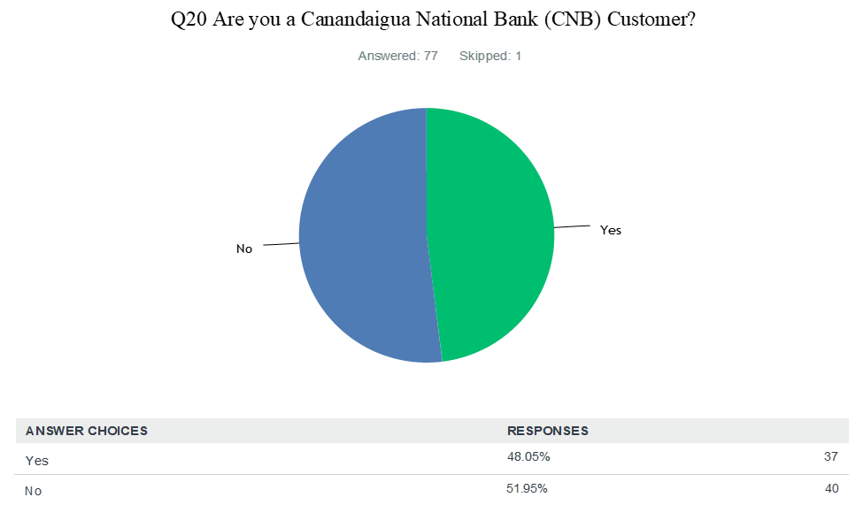
Survey Key Findings

Slide 58
Survey Key Findings
Knowledge Gaps & Confidence Levels
  *40% do not know the difference between a Roth IRA and a Traditional 401(k).*
  Only 11% feel “very/extremely confident” in understanding investments; 26% are “not confident at all.”
  Budgeting confidence is moderate, but 15% report low confidence.
  Only 37% budget regularly; 23% do not budget at all → awareness vs. action gap.
  Long-term financial planning confidence is low: only 21% feel “very/extremely confident.”
  Mortgage understanding: 51% confident, but 25% still unsure.

Slide 59
Survey Findings
Where People Seek Advice
  44% rely on family/friends (the most common source).
  Only 14% turn to banks/credit unions → opportunity for CNB to fill an expert-advisory role.
Trust in Banks & CNB
  General bank trust is low: 47% “neutral/some trust,” 24% “trust.”
  *CNB scores higher*: 42% “neutral/some trust,” 30% “trust.”
  Stronger reputation than large institutions, but room to increase transparency.

Slide 60
Survey Findings
Value of Local Ownership
  75%+ rate local, community-focused banking as “moderately,” “very,” or “extremely important.”
  Aligns directly with CNB’s brand identity and market advantage.
Education Needs Identified
  Retirement planning – 55%
  Investing – 51%
  Budgeting – 39%
  Credit & debt management – 25%
  Fraud protection – 14%

Slide 61
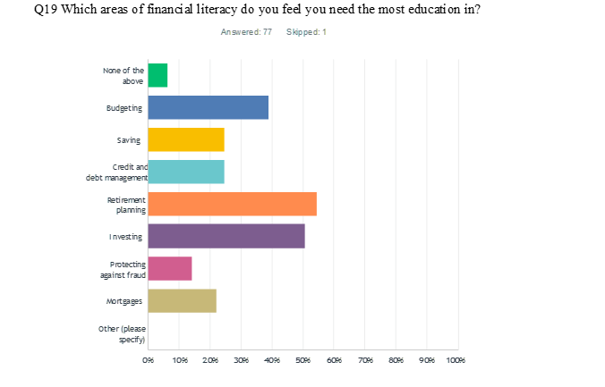
Survey Findings
Value of Local Ownership
  75%+ rate local, community-focused banking as “moderately,” “very,” or “extremely important.”
  Aligns directly with CNB’s brand identity and market advantage.
Education Needs Identified
  Retirement planning – 55%
  Investing – 51%
  Budgeting – 39%
  Credit & debt management – 25%
  Fraud protection – 14%

Slide 62
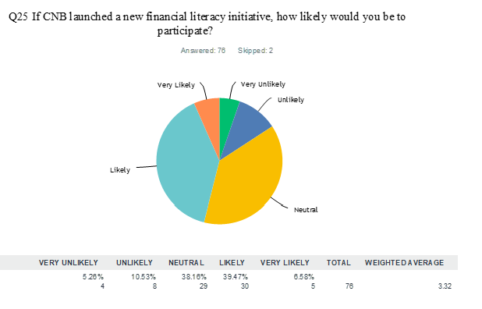
Survey Findings
Preferred Learning Formats
  Online courses – 37%
  One-on-one coaching – 36%
  Workshops – 33%
  Clear preference for flexible, interactive, personalized learning.
Likelihood of Participation & Customer Impact
  79% would be “likely/very likely” to participate in a CNB financial literacy program.
  *31% would become CNB customers if a literacy program were launched; 54% said “not sure,” indicating strong potential.*

Slide 63
Conclusion
Plan strengthens CNB’s leadership and community impact.
Builds financial confidence across generations.
Supports long-term trust and growth with financial institutions.
Banks (CNB in particular) have the general public’s financial well-being always in mind.
Will attract future customers to the bank

Slide 64
Questions?
Thank you!

